Slide 1
Thesis Application Abstract: Current Continuity in Auroral System Science
van Irsel, J.¹
Thesis Advisor: Lynch, K. A.¹
Committee Members: Liu, Y.¹, LaBelle, J. W.¹, Zettergren, M. D.²
¹Dartmouth College
²Embry-Riddle Aeronautical University

Slide 2
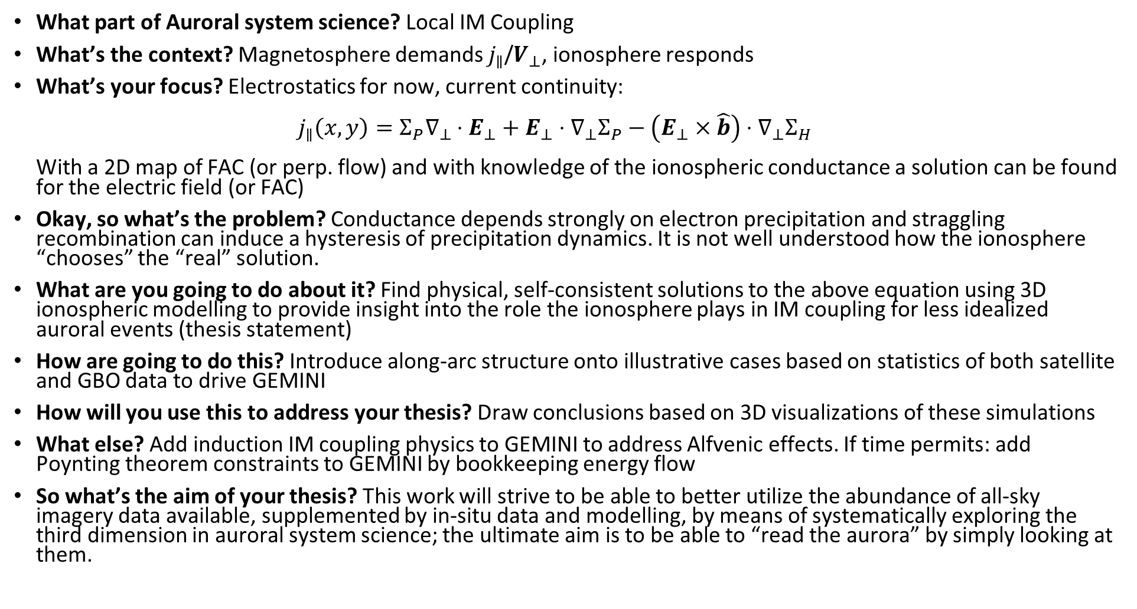
What part of Auroral system science? Local IM Coupling
What’s the context? Magnetosphere demands $j_{∥}$/$V_{⊥}$, ionosphere responds
What’s your focus? Electrostatics for now, current continuity: $j_{∥}\left(x,y\right)=Σ_{P}∇_{⊥}⋅E_{⊥}+E_{⊥}⋅∇_{⊥}Σ_{P}−\left(E_{⊥}×\hat{b}\right)⋅∇_{⊥}Σ_{H}$ With a 2D map of FAC (or perp. flow) and with knowledge of the ionospheric conductance a solution can be found for the electric field (or FAC)
Okay, so what’s the problem? Conductance depends strongly on electron precipitation and straggling recombination can induce a hysteresis of precipitation dynamics. It is not well understood how the ionosphere “chooses” the “real” solution.
What are you going to do about it? Find physical, self-consistent solutions to the above equation using 3D ionospheric modelling to provide insight into the role the ionosphere plays in IM coupling for less idealized auroral events (thesis statement)
How are going to do this? Introduce along-arc structure onto illustrative cases based on statistics of both satellite and GBO data to drive GEMINI
How will you use this to address your thesis? Draw conclusions based on 3D visualizations of these simulations
What else? Add induction IM coupling physics to GEMINI to address Alfvenic effects. If time permits: add Poynting theorem constraints to GEMINI by bookkeeping energy flow
So what’s the aim of your thesis? This work will strive to be able to better utilize the abundance of all-sky imagery data available, supplemented by in-situ data and modelling, by means of systematically exploring the third dimension in auroral system science; the ultimate aim is to be able to “read the aurora” by simply looking at them.

